Slide 1
Customer Review Analysis for British Airways

Slide 2
Contents:
Web scraping data of British Airways from website Skytrax
Analysing the data
Insights

Slide 3
Web Scraping Data from Skytrax
From the website Skytrax, we have extracted the reviews data of British Airways
The reviews play a significant role for a company:
Customer Feedback : Valuable feedback on company’s services and customers experience
Brand Reputation : Positive Reviews can help build a company’s brand reputation
Metrics for improvement : Measurable metric to track customer satisfaction and identify the areas of improvement.

Slide 4
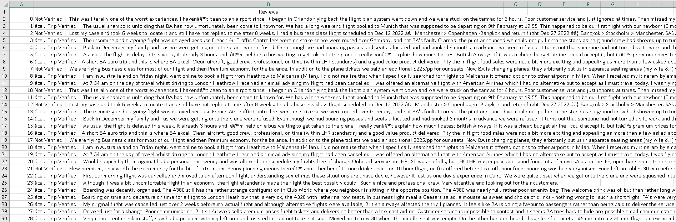
Extracted Data
Get the data from here.

Slide 5
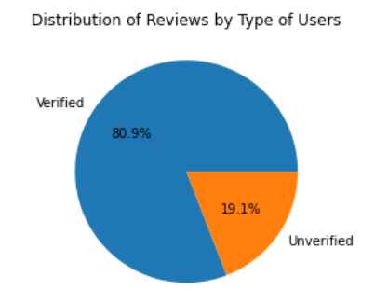
Data Analysis
Initially, reviews segregated on basis of Verified and Unverified Users

Slide 6
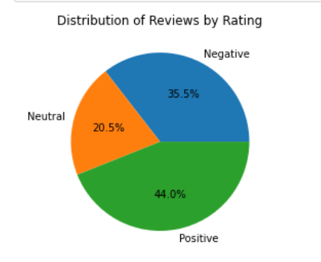
Using NLP to analyze the text data
Sentiment Analysis:
Using Vader library in Python, customer reviews were analyzed for sentiment. 44% of the reviews were found to be positive, 35.5% were negative, and 20.5% were neutral.

Slide 7
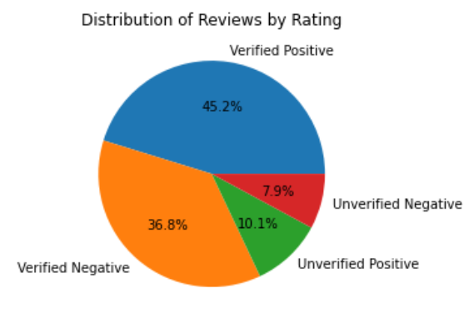
Dive deeper into Reviews
The verified users have a higher positive sentiments score as compared to negative sentiments.
The positive unverified users reviews are also greater than negative ones.

